Slide 1
An introduction to Plotting in MATLAB
2015-03-19
Rikard Johansson
Department of Biomedical Engineering (IMT)
Linköping University
rikard.johansson@liu.se
CC – isbgroup.eu

Slide 2
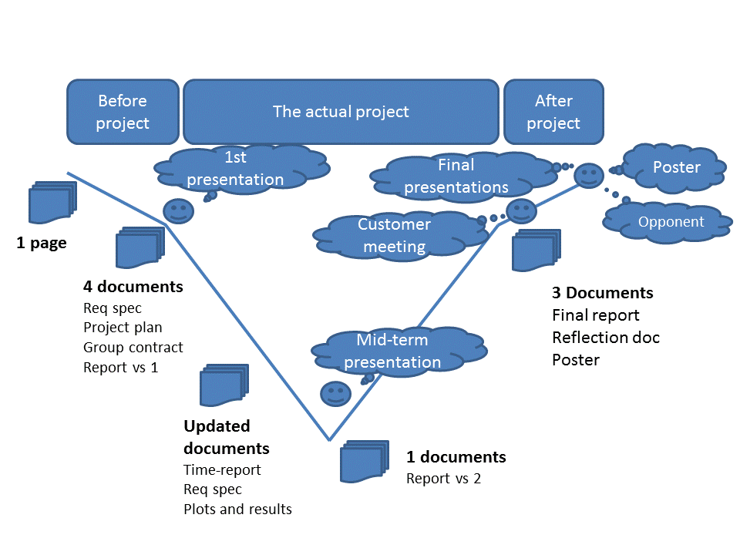
You are here!

Slide 3
Outline
Part I
About plotting in MATLAB
How can you plot
What should you plot
What shouldn’t you plot
Basic plotting
Common tools
Customization
Simple editing
Part II
Customizing your plot using scripts
Linewidth etc.
Axes, labels, legends, titles
Part III
Customizing your plot using scripts
Handles
Part IV
Multiple Figures
Saving and Exporting
Additional Tools

Slide 4
The Examples
All examples used in this lecture will have an identification number.
You can find the code for these examples on Lisam, along with the slides for this presentation.
The examples are divided into cells.
Run only the current cell by right-clicking and choosing “Evaluate Current Cell” (shortcut: Ctrl+Enter in windows)

Slide 5
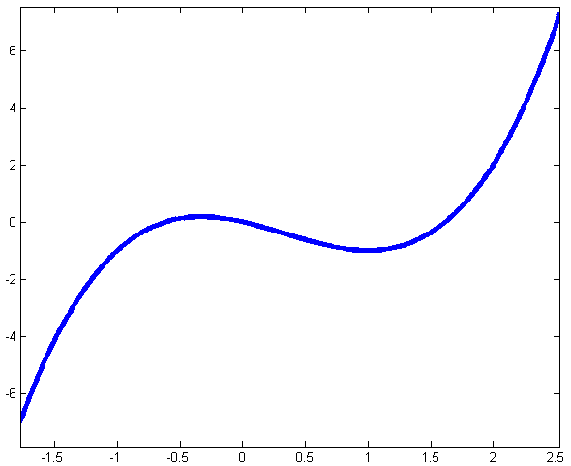
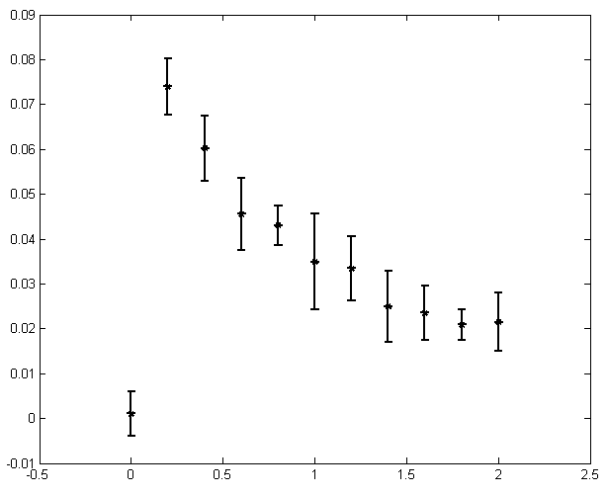
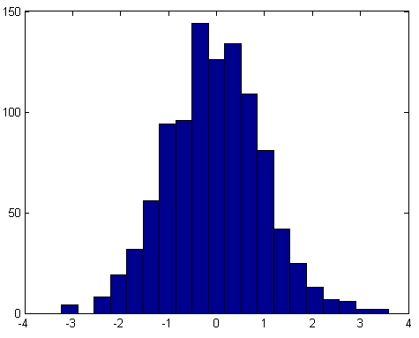
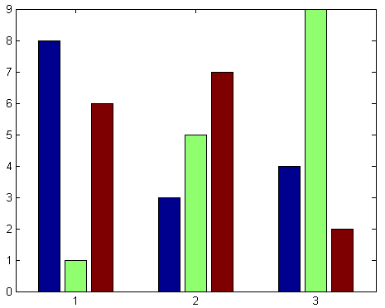
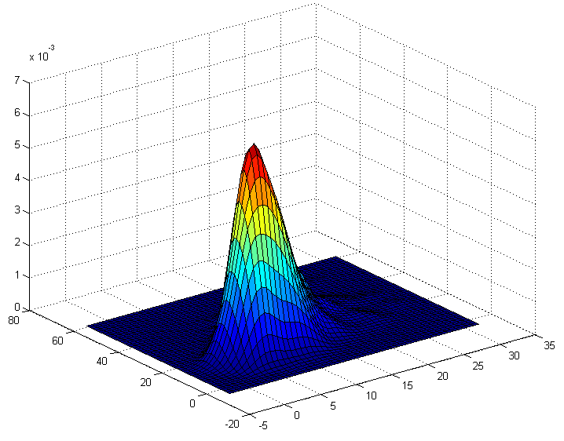
Some things you can do
plot
errorbar
pie
hist
bar
surf
Find more examples at :
http://www.mathworks.se/discovery/gallery.html
http://www.mathworks.se/help/matlab/creating_plots/figures-plots-and-graphs.html

Slide 6
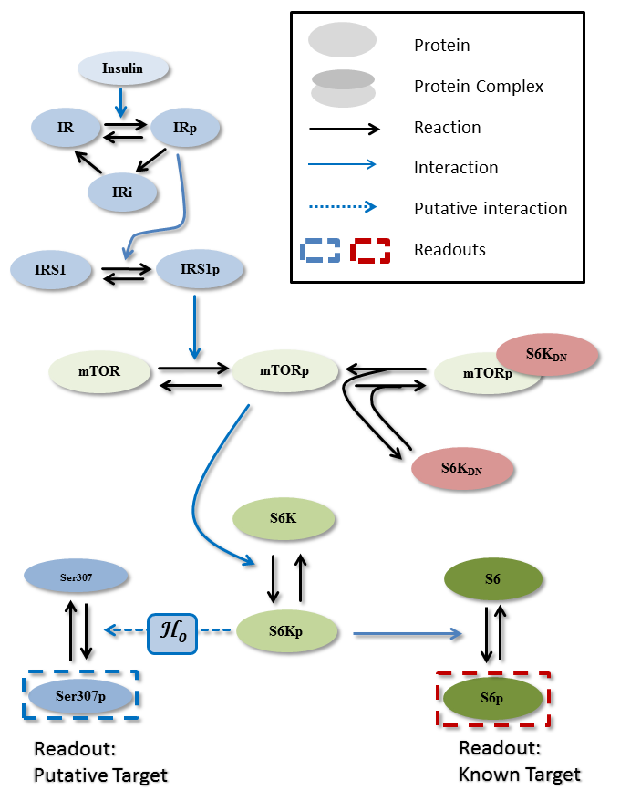
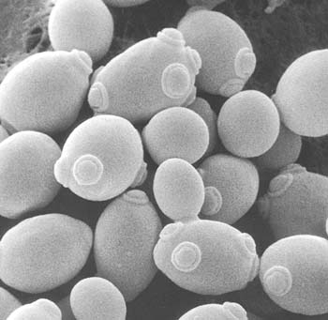
How about this?
If you are not presenting data. Use a GUI-friendly program.
Powerpoint
Adobe illustrator
etc.

Slide 7
The Focus
plot
The techniques discussed can most often be directly applied to any plotting/chart-type

Slide 8
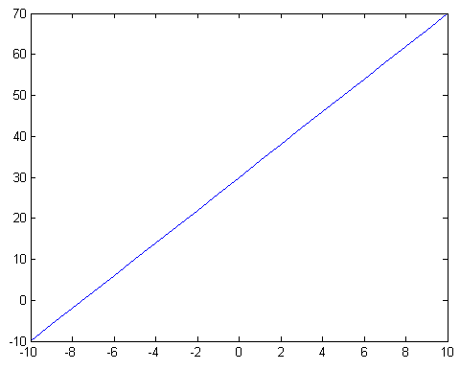
The plot command
>> plot(x,y)
This will plot x vs y in the current figure. If there is no current figure, it will create one for you.
%% Example 1
…
y = 4x+30

Slide 9
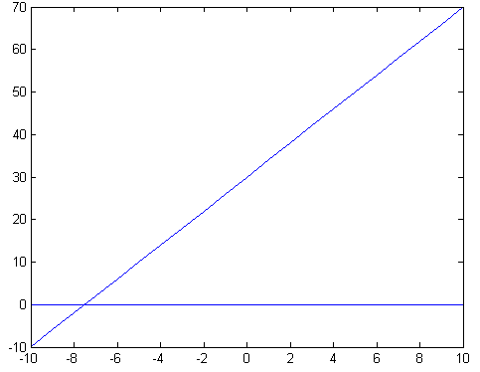
Plotting multiple things
>> hold on
To prevent MATLAB from erasing the old plot from figure. Use when you want to plot several (independent) graphs in the same window.
%% Example 2
…
y = 4x+30
y2 = 0
>> hold off
To turn it off again

Slide 10
Alternatives sometimes used
>> errorbar(x, y, σ)
For plotting data with noise
>> semilogx(x, y)
For having a logarithmic x-axis.
>> semilogy(x, y)
For having a logarithmic y-axis.
>> loglog(x, y)
For both axes in log-scale
%% Example 3
…
%% Example 4
…
%% Example 5
…
%% Example 6
…

Slide 11
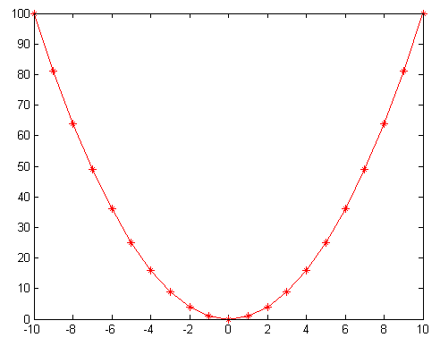
Customize your plot
>> plot(x, y, s)
s is a string controlling: color, marker type, and line type.
E.g. s = 'r*-'
%% Example 7
…
y = x²
Color is red
Data points are marked with *
The line type is a solid line

Slide 12
Customize your plot
>> help plot
s = 'r*-'

Slide 13
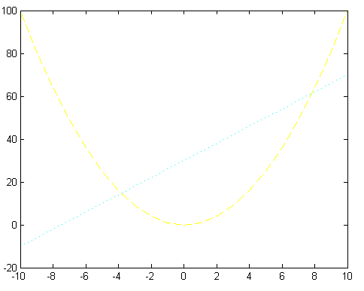
Choose wisely
Think about colors and line types. Are they easy to see? Figures will look different on your computer screen, on a printed A4, on a poster, or in an presentation.
%% Example 8
…
y = x²
Dashed yellow (s = 'y--')
y2 = 4x +30
Dotted cyan (s ='c:')

Slide 14
Edit your plot

Slide 15
An introduction to Plotting in MATLAB
2015-03-19
Rikard Johansson
Department of Biomedical Engineering (IMT)
Linköping University
rikard.johansson@liu.se
CC – isbgroup.eu

Slide 16
Outline
Part I
About plotting in MATLAB
How can you plot
What should you plot
What shouldn’t you plot
Basic plotting
Common tools
Customization
Simple editing
Part II
Customizing your plot using scripts
Linewidth etc.
Axes, labels, legends, titles
Part III
Customizing your plot using scripts
Handles
Part IV
Multiple Figures
Saving and Exporting
Additional Tools

Slide 17
Edit your plot

Slide 18
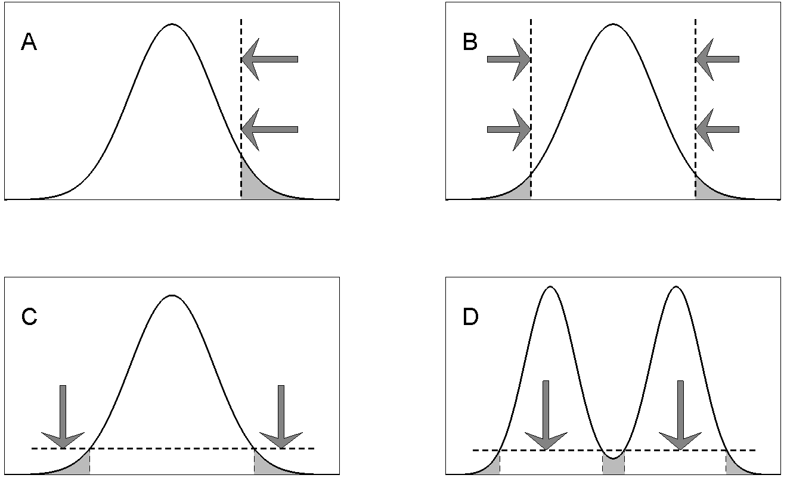
Scripted
Here’s the latest figure
Looks nice but…
…please change everything
OK!
…please change X, Y and Z

Slide 19
Editing in script based environment
Saves you time
When you repeatedly want to plot the same (or slightly different figure). E.g. the plot functionality in the cost-function
Want to use the same settings for a new figure (copy it)
Allows you to make sweeping changes, like changing the thickness of all lines, with one stroke of the key.
Reduces human error (messing things up)
Easier for a co-worker to change/modify. Just send them the script!

Slide 20
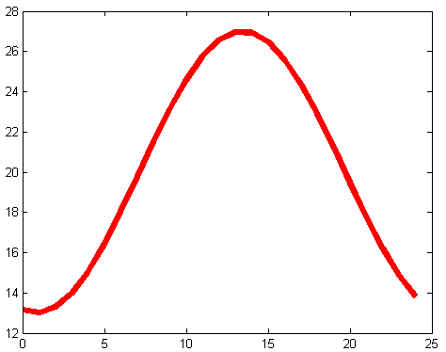
The Plot Thickens…
The 'linewidth' input allows you to plot with any thickness you want.
Similarly you can change the size and color etc. of the marker (see the matlab help).
%% Example 9
…
plot(x,y,'r', 'linewidth',5)
Note: you can replace the 5 with a variable, and use that variable for all your plots, allowing for easy change of all plots.

Slide 21
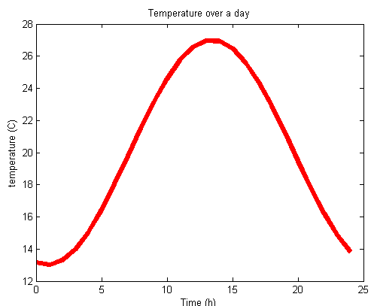
Labels/Titles
>> xlabel
To set a label for the x-axis
>> ylabel
To set a label for the y-axis
>> title
To set a title for the plot
xlabel('Time (h)')
ylabel('temperature (C)')
title('Temperature over a day')
%% Example 10
…

Slide 22
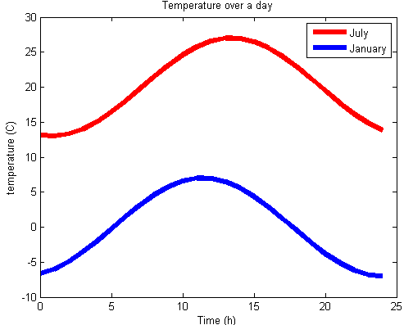
Legends
>> legend
Use when plotting multiple things in the same window. Name them in the order you plotted them.
You can decide where the legend box appears with the 'location' input for legend.
>> help legend
%% Example 11
…
legend('July', 'January')
%% Example 12
…
To see an example of the 'location' input

Slide 23
An introduction to Plotting in MATLAB
2015-03-19
Rikard Johansson
Department of Biomedical Engineering (IMT)
Linköping University
rikard.johansson@liu.se
CC – isbgroup.eu

Slide 24
Outline
Part I
About plotting in MATLAB
How can you plot
What should you plot
What shouldn’t you plot
Basic plotting
Common tools
Customization
Simple editing
Part II
Customizing your plot using scripts
Linewidth etc.
Axes, labels, legends, titles
Part III
Customizing your plot using scripts
Handles
Part IV
Multiple Figures
Saving and Exporting
Additional Tools

Slide 25
Handles
A handle is a pointer to another object
A figure
An axis
Something within a figure (label, legend, plot, etc)
You can manipulate the object by manipulating the handle.
The >>get and >>set commands allows us to read and change the properties of the handles.
>> gca
Is a MATLAB in-built handle for the current axis.
It always exists, you don’t have to define it.
>> get(gca)

Slide 26
Handles: Fontsize
>> get(gca)
By manipulating the gca handle we can change the fontsize used in the figure.
>> set(gca, 'fontsize' , 15)
gca always change for the current/active figure.
If you have several figures open, be sure to select the right figure first (click on it).
You can alternatively “store” a permanent reference to that handle, e.g.:
>> myHandle1 = gca;

Slide 27
Handles: Fontsize
The size of the axis, and the legends changed
Not the labels and title.
Fix by running the cell again, or ascribe specific handles
%% Example 13
…
set(gca, 'fontsize' , 15)

Slide 28
Assign your own handles
You can assign handles to many things in matlab.
Easiest way is to do it when creating them:
a = plot(x,y)
b = xlabel('time')
c = legend('january')
d = title('Fantastic Plot')
a, b, c, and d are all handles.
You can manipulate them using the >> get and >> set commands

Slide 29
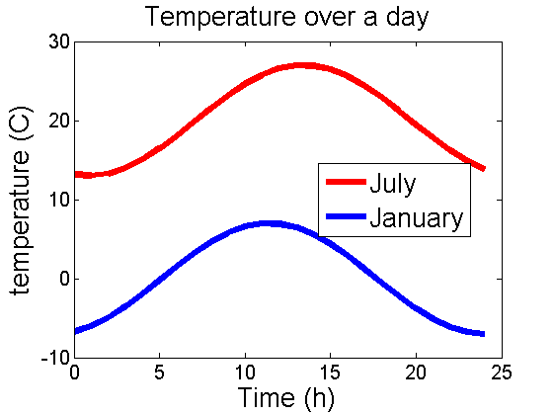
Can you handle it?
In the example below a separate handle is created for each object we want to change the fontsize for.
The >> set(handle, 'fontsize' , newValue) takes care of the rest
%% Example 14
…
One fontsize for the axes.
A second for the labels, title, and legend.

Slide 30
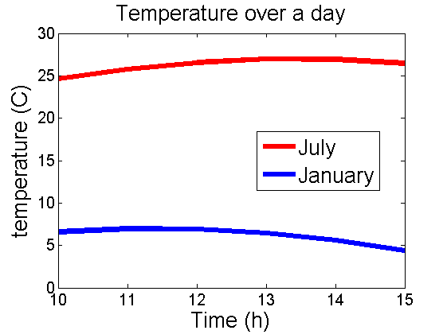
Other uses of handles
Changing range of the axis (the limits)
Setting where the “ticks” are.
Changing the names of the ticks.
Change between log-scale and normal scale.
%% Example 15
…
Xlim to [10 15]
Ylim to [0 30]

Slide 31
An introduction to Plotting in MATLAB
2015-03-19
Rikard Johansson
Department of Biomedical Engineering (IMT)
Linköping University
rikard.johansson@liu.se
CC – isbgroup.eu

Slide 32
Outline
Part I
About plotting in MATLAB
How can you plot
What should you plot
What shouldn’t you plot
Basic plotting
Common tools
Customization
Simple editing
Part II
Customizing your plot using scripts
Linewidth etc.
Axes, labels, legends, titles
Part III
Customizing your plot using scripts
Handles
Part IV
Multiple Figures
Saving and Exporting
Additional Tools

Slide 33
Multiple figures
>> figure()
Will open a new, empty, plot.
>> figure(X)
Will navigate to the Xth plot, or create it if it doesn’t exist.
The examples used herein, uses this.
Sometimes you wish to make an array (a matrix) of figures. This is accomplished using the >> subplot command.
>> subplot(y, x, number)
Rows Columns Element #

Slide 34
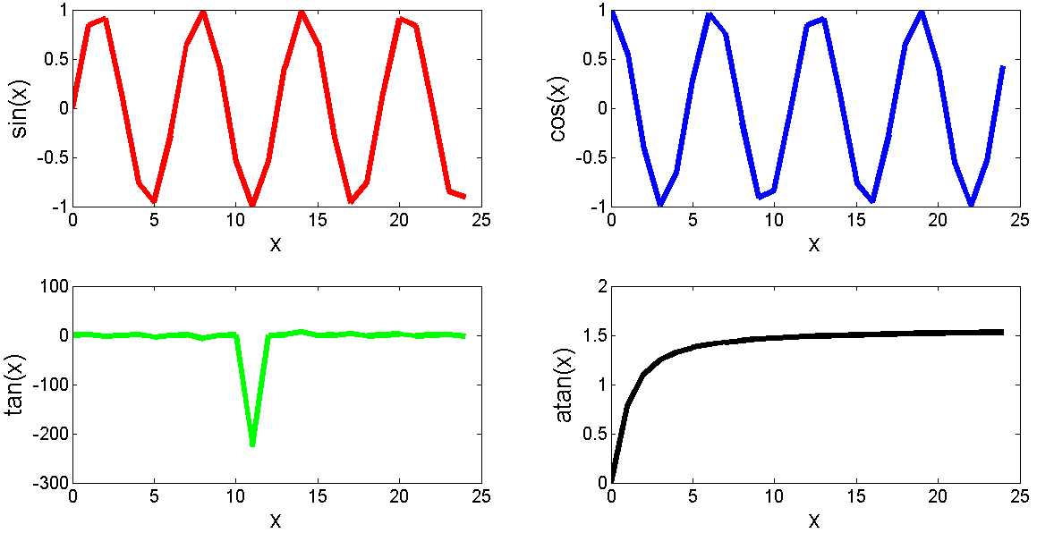
Subplot
A 2 x 2 subplot array
%% Example 16
…

Slide 35
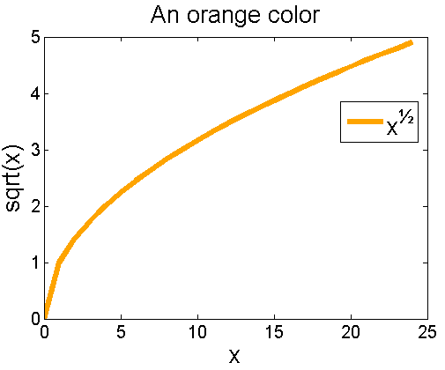
Choose your own color
Find a color you like. Look for instance here:
http://cloford.com/resources/colours/500col.htm
Get the RGB values
Change to values between 0 and 1 by dividing with 255.
Use the 'color' property in plot
%% Example 17
…

Slide 36
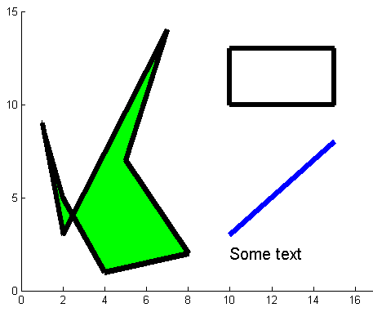
Additional tools
>> line
Draws lines in your plot.
>> rectangle
To draw rectangles (and circles)
>> fill
To draw any polygon you want.
>> text
To write text in your figure
%% Example 18
…

Slide 37
Saving your pictures
The easiest way
Or, if you wish to do it script style
Use the >> print command.
>> help print
Will tell you how to save to a particular file format, and to increase the resolution (dpi)

Slide 38
Remember
Check that your plots will be easy to read
Use the MATLAB help to learn more about the functionalities.
Google it! Someone else probably had the same problem.
Ask on Lisam!

Slide 39
Questions/Comments?

